Slide 1
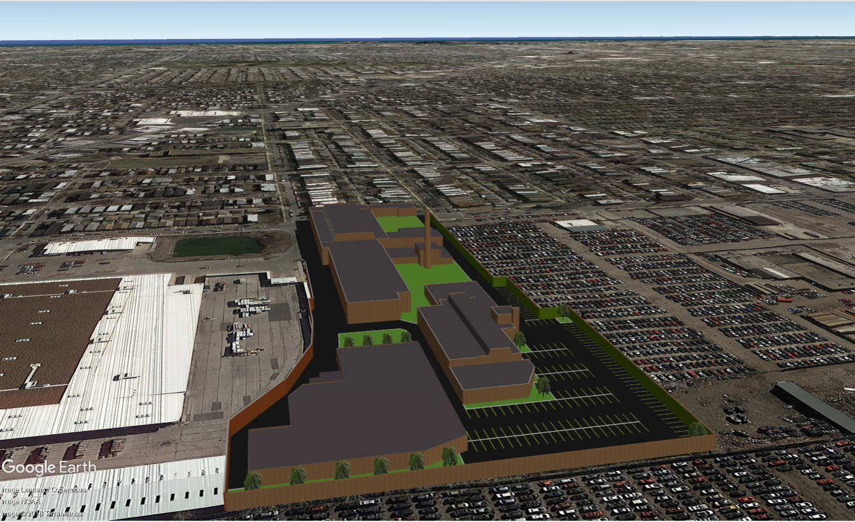
HUMBOLDT PARK LIT – RENT ANALYSIS

Slide 2
STRATEGY
As Chicago continues to evolve into a burgeoning tech hub; local, as well as companies expanding/relocating from areas such as the San Francisco Bay Area and New York based tech firms, will be looking for Class A creative work environments with top amenities to attract and retain talent.
The Humboldt Park LIT project provides flexibility with respect to size, amenities, access to public transportation and price point tech firms are considering when reviewing Chicago as an option.
Fulton Market/West Loop
Fulton Market has become ground zero and the main beneficiary of the River North overflow over the past handful of years, with tech names such as Google, Glassdoor, WeWork and Uber taking up tenancy in the area. With this influx of tenants to the market, new development rents have skyrocketed to almost $60/SF Gross. Smaller tech firms and start-ups who are looking for similar office space with all of the same amenities, are being pushed to secondary markets such as Bucktown and wicker Park.
Bucktown/Wicker Park
Bucktown has up until now provided an alternative with smaller, older spaces that lack continuity and desirable amenities but provides a rent alternative in a neighborhood that previously offered reasonably priced housing.
The LIT will offer tech and maker companies an amenity rich workspace in an authentic, urban environment desirable to a contemporary workforce that Bucktown cannot currently offer.
Space in Bucktown/ Logan Square is generally available at approximately $27/SF Gross, Humboldt Park LIT offers multiple large, continuous spaces with all the amenities millennial based companies look for, at a comparable rents.
Humboldt Park LIT is a unique multi-building campus environment alternative providing a perfect mixture of Fulton Market’s urban, amenity filled buildings, with the cost-effective price point and ease of access to public transportation of Bucktown/Wicker Park.

Slide 3

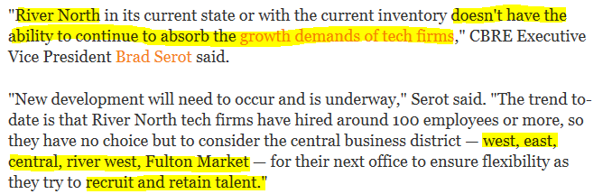


As A Tech Hub, River North is Nearing Its Limit www.bisnow.com – November 8, 2018

Slide 4
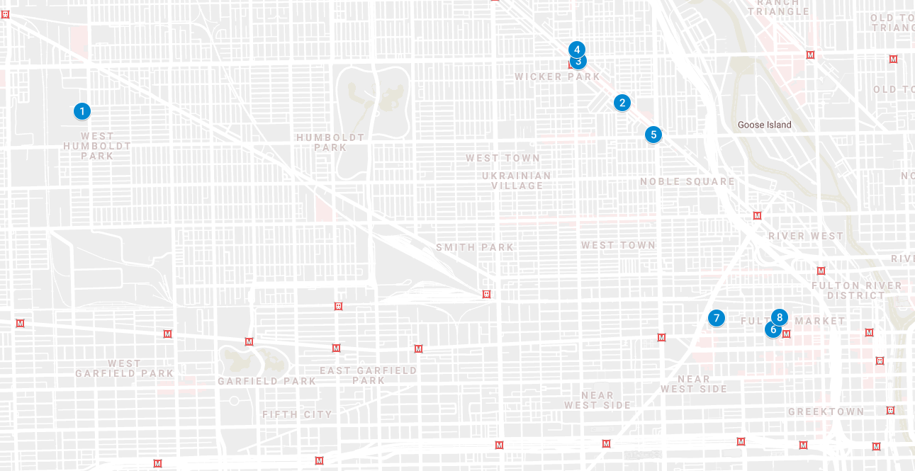
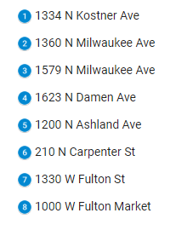
Comps – Wicker Park &
Fulton Market

